Slide 1

Object detection using deep neural networks
Author
Comănac Dragoș-Mihail

Slide 2
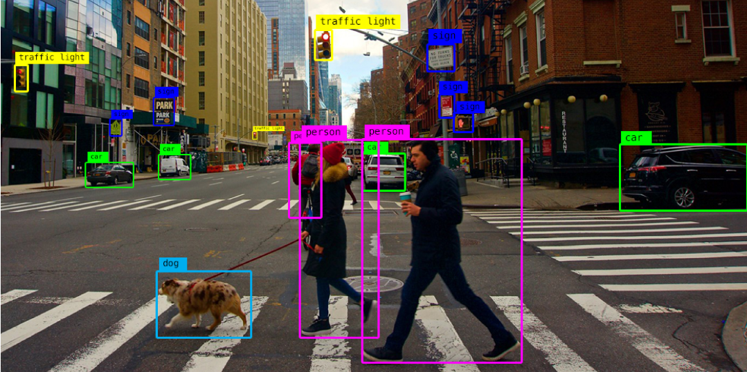
Why?
Source: https://alwaysai.co/blog/object-detection-for-businesses

Slide 3
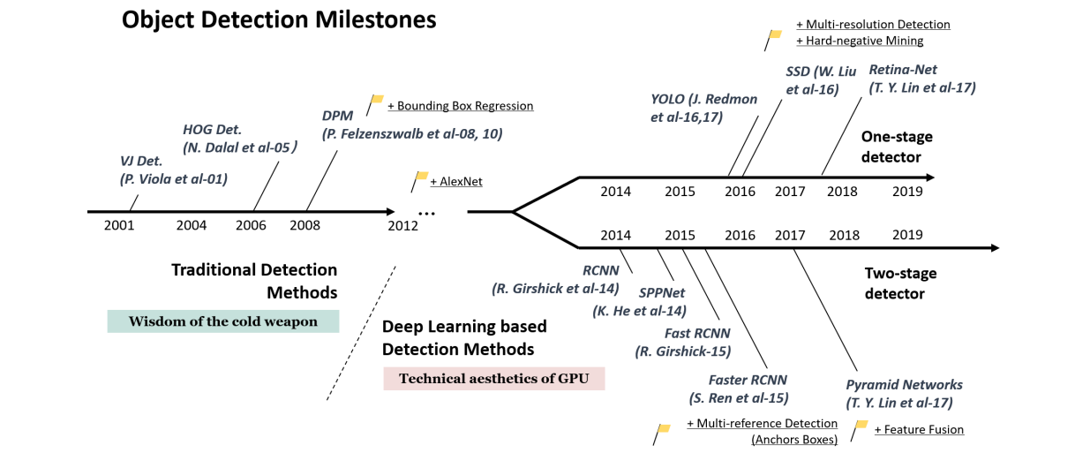
Placement in the general field
Source: Zou, Z., Shi, Z., Guo, Y., Ye, J., 2019. Object Detection in 20 Years: A Survey. ArXiv abs/1905.05055

Slide 4

General architecture

Slide 5
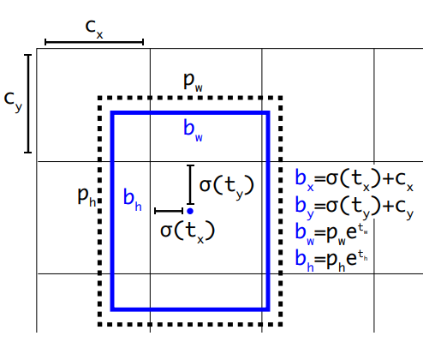
You Only Look Once (YOLO)
Source: Joseph Redmon and Ali Farhadi. YOLO9000: Better, Faster, Stronger. 2017 IEEE Conference on Computer Vision and Pattern Recognition (CVPR), pages 6517–6525, 2017

Slide 6
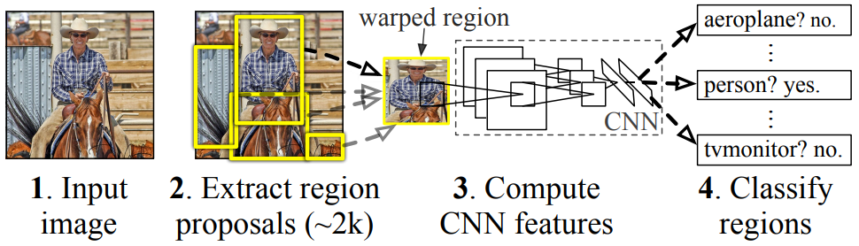
Region based convolutional neural networks (R-CNN)
Source: Girshick, R., Donahue, J., Darrell, T., Malik, J., 2014. Rich feature hierarchies for accurate object detection and semantic segmentation, in: Proceedings of the IEEE conference on computer vision and pattern recognition, pp. 580–587

Slide 7
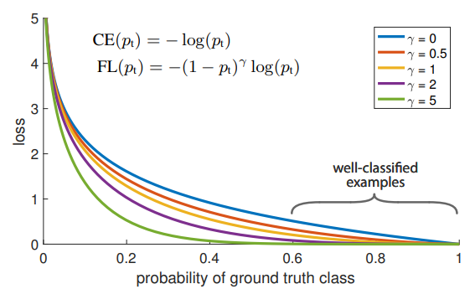

Focal Loss for Dense Object detection (RetinaNet)
Source: Lin, T.Y., Goyal, P., Girshick, R., He, K., Doll ́ar, P., 2017b. Focal loss for dense object detection, in: Proceedings of the IEEE international
conference on computer vision, pp. 2980–2988

Slide 8
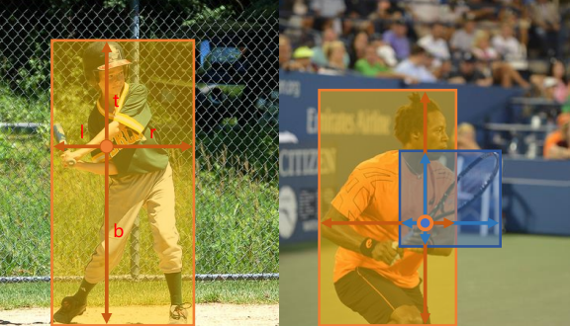
Fully Convolutional One-Stage Object Detection (FCOS)
Source: Tian, Z., Shen, C., Chen, H., He, T., 2019. FCOS: Fully Convolutional One-Stage Object Detection, in: Proceedings of the IEEE/CVF
international conference on computer vision, pp. 9627–9636

Slide 9
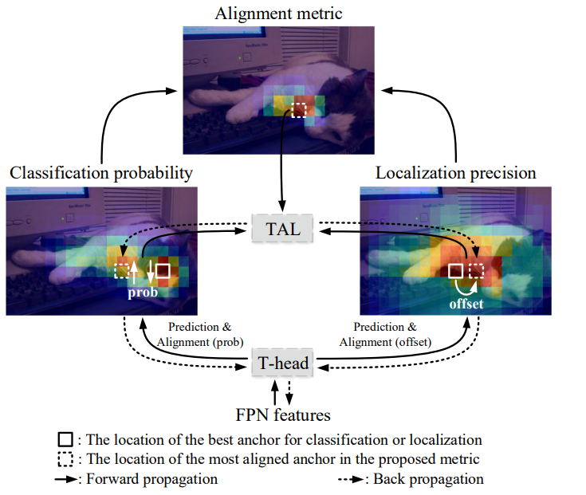
Task-aligned One-stage Object Detection (TOOD)
Source: Feng, C., Zhong, Y., Gao, Y., Scott, M.R., Huang, W., 2021. TOOD: Task-aligned One-stage Object Detection, in: IEEE/CVF International
Conference on Computer Vision (ICCV), IEEE Computer Society. pp. 3490–3499

Slide 10
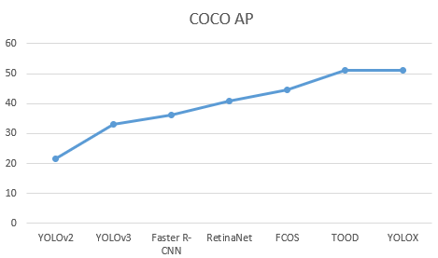
Comparison: Mean average precision (mAP) Microsoft Common Objects in Context (COCO)

Slide 11
Conclusions
End-to-end learning
Focal loss
Anchor-free
Task alignment

Slide 12
Thank you!

